Slide 1

Welcome
Grants Workshop
Thursday, February 5, 2026
Presented by: Diana Castillo
Vice President of Community Impact
Notes:
Welcome and thank you for coming – it is great to see new and familiar faces
I am DC VP community impact for THCF
Before we begin, I want to thank Mid-West Public Risk for hosting us and letting us utilization this space.
MWPR – speaker….. Say a few words
PHIL WELCOME?????
Before we start – how many in this room are first time grant applicants to the THCF?
Okay – today’s topics – NEXT SLIDE

Slide 2

Agenda
Today’s Discussion
Who is Truman Heartland Community Foundation (THCF)?
2026 Competitive Grants Highlights
Overview of 2 Grantmaking Programs
Review Applicant Dashboard
Preview Online Applications
Q&A
Notes:
Today’s Discussion
Who is THCF?
Review major changes for 2024
Overview of 2 Grantmaking Programs
Preview Online Applications
Q&A

Slide 3
Who is THCF?
New mission: to inspire generosity and advance community well-being
through the power of charitable giving.
Founded in 1982 – Community Foundation
nonprofit that pools donations to support charitable causes
Eastern Jackson, Cass, Lafayette Counties & Suburban KC
Nearly 900 Fundholders
FY25 $18MM awarded – Highlights Include:
scholarships ($970K), competitive grants ($518K)
& fundholder directed donations ($10MM)
Initiatives – Mission Expanding Programs
Notes:
in Eastern Jackson CouMISSION improve area communities by promoting and serving private giving for public good
Founded in 1982 - Community Foundation - $100MM Assets
We have a BOD and 4 advisory boards that represent people who work and/or live in our area. Members of the board and all 4 advisory boards are members of the GRANTS CTTE - 17
Eastern Jackson, Cass, Lafayette Counties & Suburban KC
Nearly 900 Fundholders – DAFs – Endowments – Scholarships - Agency
FY24 $8.9MM in scholarships, competitive grants & fundholder directed donations
Provide Leadership on community Initiatives and Mission Expanding Programs – that enhance our communities.
Youth Advisory Council was the first initiative – 27 years ago Our School of Philanthropy for high school students – 65 students 10 EJ high schools
Community for All Ages worked towards inclusive, age-friendly neighborhoods AND communities and across the region.
Job Skills for New Careers – FOCUS was on the Economic status of individuals by providing a pathway to higher-paying, in-demand careers through certified training/education & wrap-around services.
Affordable Housing - access to rental units and home ownership opportunities nty.

Slide 4
2026 Grant Highlights
Only apply to ONE grant program Jelley OR Community Grants
Agency can only receive funding 3 years in a row - re-set in 2024
10% of available funds will go to new grantees/agencies <$100K (both J & CG) = ~$51K
Agencies w/Foundations/City Governments/Agencies w/>$100MM assets need to show why monies are needed
Fiscal Sponsor – agency implementing program must write grant
Committee seeking details; please describe/don’t assume
Use your words – be specific and strategic (less room for narrative in 2026)
Previous Grantees – Final Reports matter - follow-ups must be completed
Incorrect attachments – if time allows, able to correct; if not rejected
Resources & Pages – grant writing, fund development, application examples, marketing
Previous grantees – agencies and programs – review if curious
Notes:
GRANT CHANGES Beginning in 2024
The committee came together to address topics that came up during last year’s review process – this meeting resulted in these changes.
Only apply to ONE grant program Jelley OR Community Grants
Agency can only receive funding 3 years in a row – ’24 reset OFF ONE YEAR, then can reapply – NO DIFFERENT PROGRAM must take one year off
10% of available funds will go to new grantees
Last year we enhanced questions because the Committee seeking more details in certain areas. More demographic details regarding your BOD and the population you service. ALSO, the check-boxes for communities served are gone – will need to describe
Incorrect attachments – Preliminary review by staff – email grantee stating errors and given time to fix. If wrong, proposal will not move forward. This courtesy is given only if time allows. Need to be submitted at least a week before deadline.
Added Resources & Pages – last year we added resources for you– enhanced section for nonprofits seeking grants – there are a variety of articles and webinars regarding grant writing tips, templates and budgets, fundraising strategies and marketing tips and non-profit fund development. There is also a video tutorial for those of you who have not used our grants portal

Slide 5

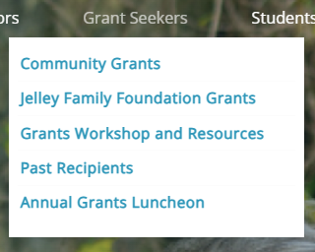

www.THCF.org – Website Grant Seekers
Notes:
When you log on to our website – this is the home page
You can see the red circle – that is where the grants information is located
If you go to the “grants seeker” page general overview of our grants process –
Each grant opportunity has its own page – JELLEY & COMM GRTS
Resources – this is where you will find webinars and articles relating to grant wiring and fund development – and portal tutorials
Past recipients is a pdf of recipients 2021 to 2024 grants luncheon that highlights all grants awarded.
And pictures of the luncheon event.

Slide 6


www.THCF.org – Website Grant Seekers
Notes:
When you log on to our website – this is the home page
You can see the red circle – that is where the grants information is located
If you go to the “grants seeker” page general overview of our grants process –
Each grant opportunity has its own page – JELLEY & COMM GRTS
Resources – this is where you will find webinars and articles relating to grant wiring and fund development – and portal tutorials
Past recipients is a pdf of recipients 2021 to 2024 grants luncheon that highlights all grants awarded.
And pictures of the luncheon event.

Slide 7
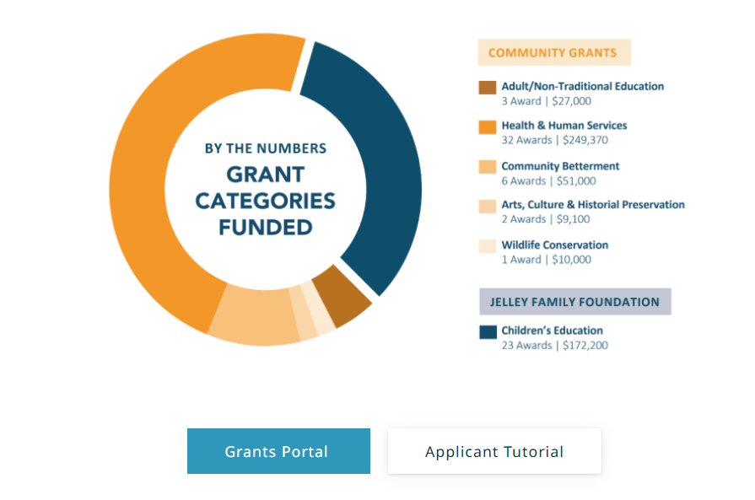
https://www.thcf.org/grant-seekers

Slide 8

Info & Knowledge are POWER
https://www.thcf.org/grant-seekers
Notes:
SHOW RESOURCES
Grant seekers
Community Grant
Jelley
Resources
Past Recipients
Luncheon
SHOW ZIP CODE MAP AND EDUCATION WEBINARS/ARTICLES
GO TO COMMUNITY PAGE – show 501c3 info
GO TO NEXT SLIDE

Slide 9

2 Competitive Grantmaking Programs
Jelley Family Foundation for Children’s Education
* * *
Community Grants
Together, ~$514,000 in grant monies available in 2026
@ least 10% = ~51,400 for new grantees/agency budget <$100k
Notes:
2 grant programs:
Jelley Family Foundation for Children’s Education
Community Grants
Organizations can apply to only ONE – HOW MANY ARE THINKING ABOUT APPLYING TO JELLEY? HOW MANY COMMUNITY GRANTS?
Last year we had 130 applicants requesting $1.1MM in requests

Slide 10
Who is Eligible to Apply?
Agencies in good standing by the IRS
501(c)(3) Nonprofits, Units of Local Governments, or
Public/Private Schools (K-12), School Districts & Community Colleges
Agencies Located in and/or Serving Eastern Jackson County (East of I-435),
suburban Jackson County (outside KC), or Cass County
Zip code map on website to determine service area – “grantseekers”
Grants must benefit the residents and communities within the THCF service area
Agencies who have completed all previous follow-ups assigned
** Agencies that have not received funding 3 years in a row**
(The count began in 2024) If you received a grant in 2024 & 2025 AND in 2026 – this will be your last year,
YOU CANNOT APPLY IN 2027
Notes:
Organizations that are eligible for BOTH GRANT OPPORTUNITIES
501(c)(3) organizations
Must be in good standing with the IRS
Units of Local Government – Parks & Rec, police dept.
Public Education institutions – school districts, community colleges
Must be located in and/or serving Eastern Jackson County – which we define as East of I-435, suburban Jackson County & Southern Jackson County, and Cass County is also included in our area since there is no community foundation that supports this area.

Slide 11

Funding Supports:
Competitive Grants Support...
Program/Project
    Capital Improvements
General Operating
It is recommended that your project has a start date of November/December
2026 OR begin in January 2027 - Jelley grants may start in the Fall (August-October)
Notes:
Program grants have a specific budget and specific goals, activities and outcomes
Operating grants, grantees typically use funds at their discretion—wherever they need it most – Focus on agency budget and agencies strategic plan
It is best to have a start date of Nov/Dec or Jan. Due to awards being given in November at the luncheon 11-13-25
Each year we receive approximately 130 applications requesting 1.1 million dollars

Slide 12
Evaluation Categories…keep in mind
As you write, think about:
Community Need – How clear is the problem & the solution?
Goals/Evaluation – Does the project’s activities help meet the goals and intended outcomes?
Sustainability – One-off OR project continue? Ability to sustain?
Return of Investment – How does the amount requested, compare to numbers served and/or impact on community?
Collaborative - Are creation/implementation partners involved? (0 pts)
Each worth 3 points – 12 points total
Notes:
DIANA---
Key Questions:
Community Need – How clear is the problem & the solution?
Goals/Evaluation – Does this project’s activities create the meet the goals and intended outcomes? HOW DO YOU KNOW YOUR PROGRAM WORKS?
Sustainability – Will this project continue in the future?
Collaborative - Are creation/implementation partners involved?
Return of Investment – How does the amount requested, compare to numbers served and impact on community?

Slide 13


Jelley Family Foundation for Children’s Education
FOCUS?
Educational Initiatives
Early Childhood through Traditional Post-Secondary
Outcomes are based on the act or process of teaching knowledge
Innovative programs, that ensure the success of students, especially at-risk youth
Notes:
FOCUS?
Educational Initiatives
Early Childhood through Traditional Post-Secondary
Outcomes are based on the act or process of teaching knowledge
*Programs that are innovative, help at-risk students and have collaborative partners – LIKE TO SEE

Slide 14
Jelley Family Foundation for Children’s Education
Grant Range Amounts: $5,000 - $10,000 2025 avg. $6,137
Total Available 2026: $142,597
No grant will be more than $10,000
10% of funds will go to new grantees/budget <$100K
Funding for Up to 3 years – must re-submit each year
(funding is not guaranteed all 3 years) ONE YEAR OFF – after 3 in a row
Notes:
Average Grant Amount: $5,000 - $10,000
Total Available 2024: $141K
No more than 10% of available funds to one agency
Renewable for Up to 3 years – must re-submit each year
(funding is not guaranteed all 3 years) ONE YEAR OFF – after 3 in a row

Slide 15
Jelley Family Foundation for Children’s Education
Application Due: Monday, March 9
Notification of Funding: Early July
Grants Awarded at Grants Luncheon on November 12, 2026
Final Report Due After Program Concludes or After 12 months
(whichever comes first)
Please keep these dates in mind when determining your start date in application
It is recommended that your project has a start date of August/September (beginning of school year) Late Fall 2026
OR begin in January 2027
Notes:
DIANA
Full proposals due Monday, March 10
Funding notifications made by early July
Grants Luncheon on November 13th
Final reports due at end of program or one year after funding is awarded – final report forms are on the website in the granting section and can be filled out and emailed back to foundation
Please keep these dates in mind when submitting proposal. It is not encouraged to submit a proposal that has an end date before funding is even decided on. I suggest your program begin at the end of this year or begins at the beginning of next year.

Slide 16




Jelley Family Foundation for Children’s Education
Questions?
Notes:
DIANA---
Are there any questions about the Jelley Family Foundation Endowment for Children’s Education?
Now I will talk through our Community Grants program.

Slide 17


Community Grants
FOCUS?
Arts, Culture & Historic Preservation
Community Betterment
Adult/Non-Traditional Education
Health & Human Services
Wildlife Conservation (statewide)
Notes:
FOCUS?
Arts, Culture, & Historic Preservation
Community Betterment
Adult/Non-traditional Education
Health & Human Services
Wildlife Conservation (statewide)

Slide 18
Community Grants
Grant Range Amounts: $5,000 - $10,000 2025 avg. $6,748
Total Available 2026: $372,361
Maximum grant will be $10,000 in 2026
10% will go to new grantees and/or agencies w/ budgets <$100K
Funding for Up to 3 years – must re-submit each year
(funding is not guaranteed all 3 years) ONE YEAR OFF – after 3 in a row
Notes:
Grant Range Amount: $5,000 - $7,000
Total Available 2025: $297K
Max grant was $10,000 in 2024
10% will go to new grantees
Renewable for Up to 3 years – must re-submit each year
(funding is not guaranteed all 3 years Average Grant Amount: $5,000 - $7,000

Slide 19
Community Grants
Application Due: Monday, March 23
First-Round cuts in May 2025 – Final Vote August 2026 – BOD Approve September
JSL – review – after May meeting will review applications in their focus area
YAC site visits June & July
Notification of Funding: Late September/Early October
Grants Awarded at Grants Luncheon on November 12th
Final Report Due After Program Concludes or After 12 months
(whichever comes first)
Please keep these dates in mind when determining your start date in application
It is recommended that your project has a start date of November/December 2026 OR begin in January 2027
Notes:
Diana---
NO Letter of Interest – just the online application.
Applications Due Monday, March 24
Funding notifications made by early October
Grants will be awarded at Grants Luncheon in November –
Final reports due at end of program or one year after funding – reporting done in portal
Application process is online and I will walk through that process in a minute.

Slide 20
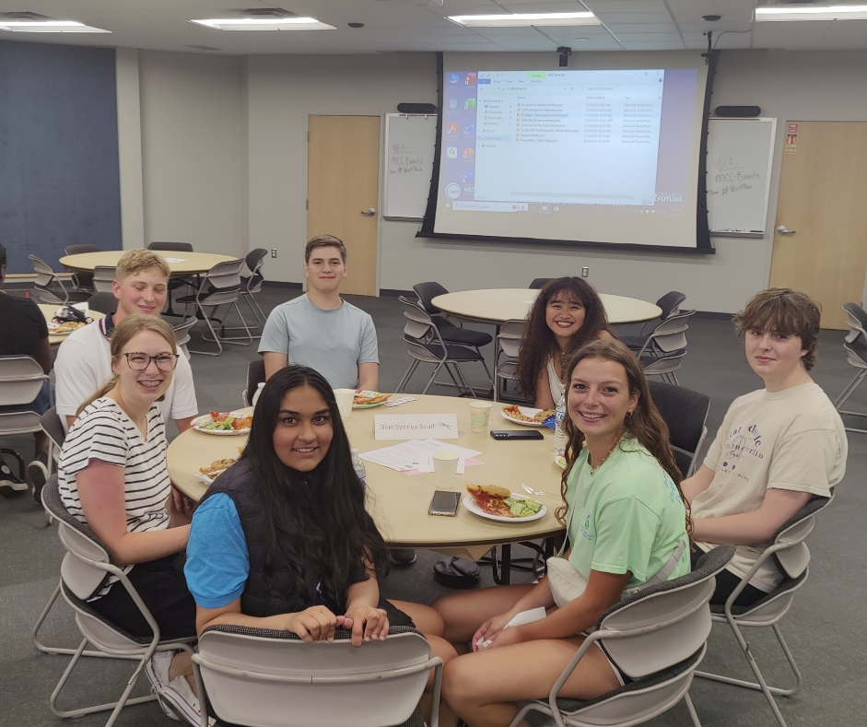
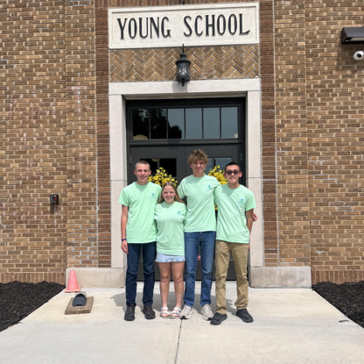
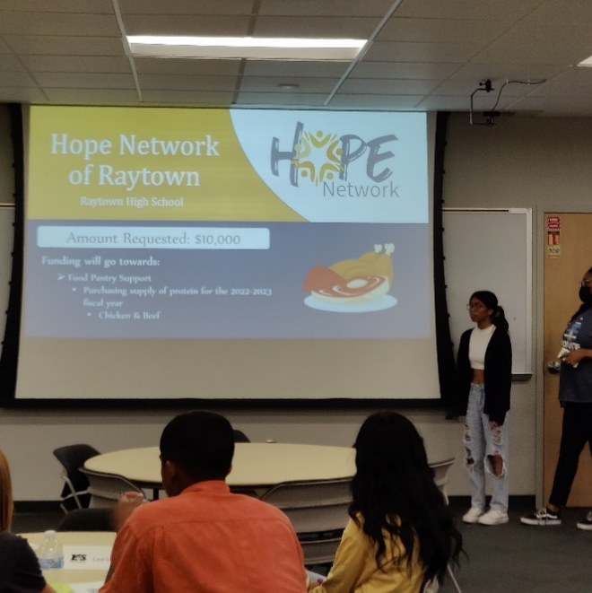
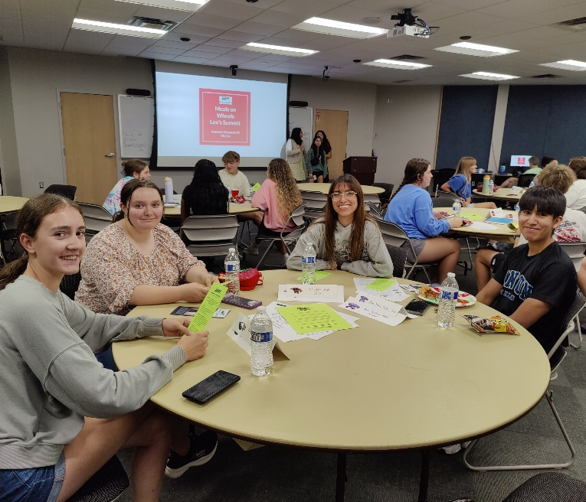

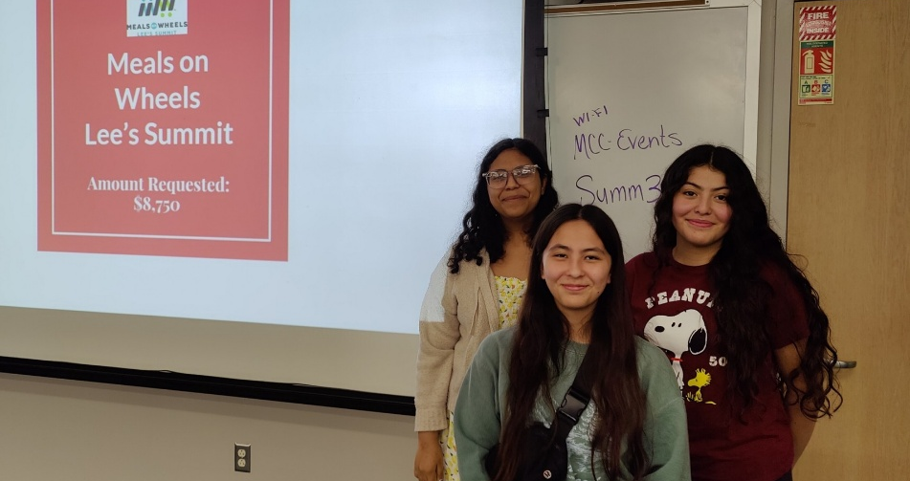
Youth Advisory Council’s
Community Grant Site Visits
Review Community Grant proposals
Site visits during June and July
Create presentations & share w/ YAC
Present findings to the committee in July
Use these visit to award their own grants
Optional – will not affect funding status if you decline
Notes:
Here at THCF we have unique aspect to our granting program – we have the THCF's Youth Advisory Council, whose students participate our Community Grants program each year. Students review grant proposals from those agencies who move past the first round of committee voting. YAC students read proposals and then conduct site-visits in June and July. Then, they create presentations that that share with other school’s YAC teams and also to the board’s grants committee. Which is made up of board members and advisory board members. YAC also uses these site visits to determine who will be awarded grants from its own Endowment Fund as part of our Community Grants program.
I will reach out to you in MAY and see if you are willing to participate. Just because you agree to a site visit doesn’t mean one will happen. The YAC students will then reach out to you and set up the visits.
This is entirely optional and will not affect your funding status if you choose to decline. Nonprofits state they enjoy meeting these kids during these sight visits and being a part of the YAC philanthropy program.

Slide 21



Community Grants
Questions?
Notes:
Diana---
Are there any questions about the Community Grants program?

Slide 22



Helpful Hints
Fill the Gap
Notes:
Diana Be specific- details about EXACTLY who you will serve in EJC will help your proposal. Examples: specific communities served, school districts, schools, zip codes, etc.
THCF Board and Staff truly want you to be successful with your proposal. Please call or shoot a quick email if you have a question or are having trouble. We are happy to help!
Conflicts of Interest- We have busy and active board members, but they recuse themselves from grants process when a conflict of interest arises because of an application from an organization they may volunteer with.
Our donors are generous- Community Grants that are not funded for the full amount requested are shared with our donors. It is our appeal called FILL THE GAP – proposals that are only partially funded will be on the list to “FTG” Last year, they donated an additional $72K dollars to organizations last years! JSL of Independence and the Youth Advisory Council are also involved with our grants committee and donate their own $$$ to our proposals.

Slide 23
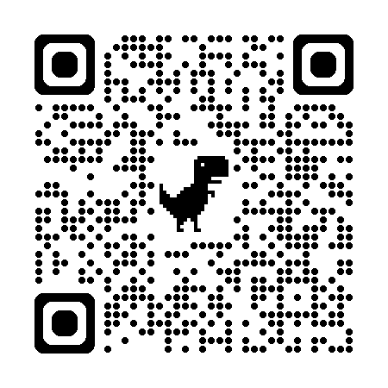
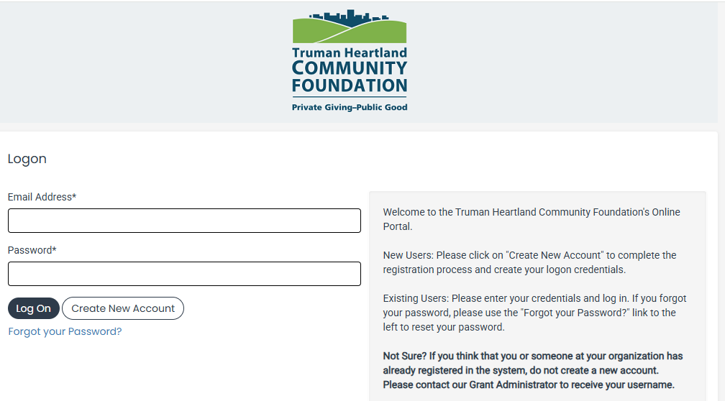
Grants Portal - bookmark
https://www.grantinterface.com/Home/Logon?urlkey=trumancf
Notes:
Now it is time for the online application –
Click Enter Grants Portal
Demonstrate how to create account and/or log into system – TUTORIAL video
Go through the community grants application - highlight/emphasize new areas
A balance sheet reports what a company owns at a specific date. An income statement reports how a company performed during a specific period.

Slide 24
Questions?
Comments?
Clarifications?
Notes:
Dian/
Any questions?

Slide 25



Follow – Like – Share
https://www.thcf.org/
Notes:
Dian/
Any questions?

Slide 26
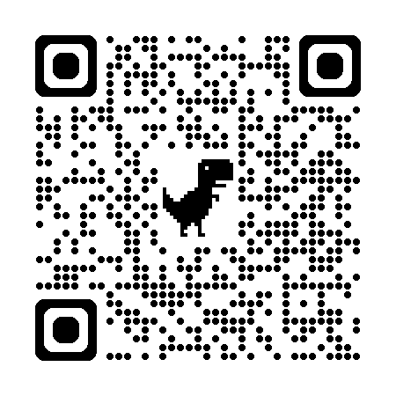
JACKSON COUNTY SPECIAL ASSESSMENT UNIT – focus on exempting certain real and business personal property from being taxed
Due 3/31/26 New Tax Exemption – 6 attachments required
ALL former exemptions expired in 2025
You may have received a letter in December
FAQ sheet on table email: specialassessment@jacksongov.org
816-881-3255

Slide 27
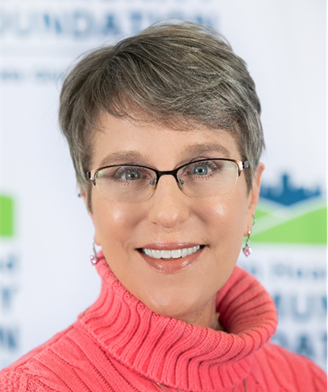
Contact Me
Diana Castillo
Vice President of Community Impact
castillo@thcf.org
816.912.4184
www.thcf.org
Notes:
Diana & Rachael – Closing and Resources
Diana is here to help. Contact her if you have any questions!

